Slide 1
ECE 5706: Resilient Computer System Design
Resilient Hardware Design – Circuit Level
Xin Xin
Assistant Professor
Electrical and Computer Engineering
ACKNOWLEDGEMENT:
Prof. Behrooz Parhami at UCSB
Prof. Ronald F. DeMara at UCF
Notes:
<number>

Slide 2

1 Fault Testing
Slide <number>
Notes:
<number>

Slide 3
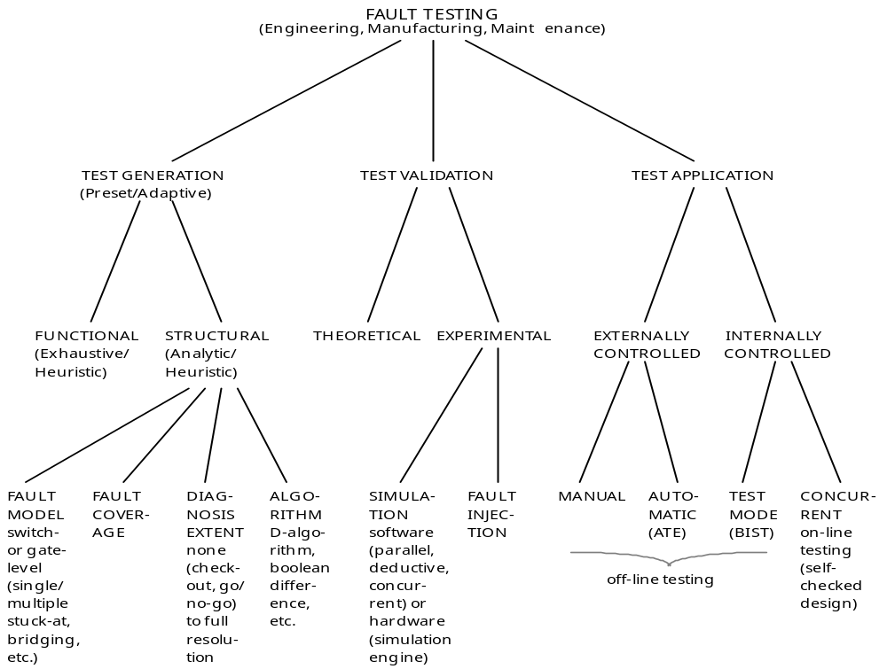
A Taxonomy of Fault Testing
Engineering
Manufacturing
Maintenance
Correct design?
Correct implementation?
Correct operation?
FAULT TESTING
Off-line testing
Slide <number>
Notes:
<number>
Parhami, B., “A Multi-Level View of Dependable Computing,” Computers & Electrical Engineering, Vol. 20, No. 4, pp. 347-368, 1994.

Slide 4
Requirements and Setup for Testing
Easier to test if direct access to
some inner points is possible
Reference value
Test pattern
source
Circuit under test
(CUT)
Comparator
Pass/Fail
Testability requires controllability and observability
(redundancy may reduce testability if we are not careful; e.g., TMR)
Reference value can come from a “gold” version or from a table
Test patterns may be randomly generated, come from a preset list, or be selected according to previous test outcomes
Test results may be compressed into a “signature” before comparing
Test application may be off-line or on-line (concurrent)
Slide <number>
Notes:
<number>
Fujiwara, H., Logic Testing and Design for Testability, MIT Press, 1985.

Slide 5
Importance and Limitations of Testing
Important to detect faults as early as possible
Approximate cost of catching a fault at various levels
Component $1
Board $10
System $100
Field $1000
Test coverage may be well below 100% (model inaccuracies and impossibility of dealing with all combinations of the modeled faults)
“Trying to improve software quality by increasing the amount of testing is like trying to lose weight by weighing yourself more often.”
Steve C. McConnell
“Program testing can be used to show the presence of bugs,
but never to show their absence!” Edsger W. Dijkstra
Slide <number>
Notes:
<number>

Slide 6
Fault Models at Different Abstraction Levels
Fault model is an abstract specification of the types of deviations in logic values that one expects in the circuit under test
Can be specified at various levels: transistor, gate, function, system
Transistor-level faults
Caused by defects, shorts/opens, electromigration, transients, . . .
May lead to high current, incorrect output, intermediate voltage, . . .
Modeled as stuck-on/off, bridging, delay, coupling, crosstalk faults
Quickly become intractable because of the large model space
Function-level faults
Selected in an ad hoc manner based on the function of a block
(decoder, ALU, memory)
System-level faults (malfunctions, in our terminology)
Will discuss in future lectures
Slide <number>
Notes:
<number>

Slide 7
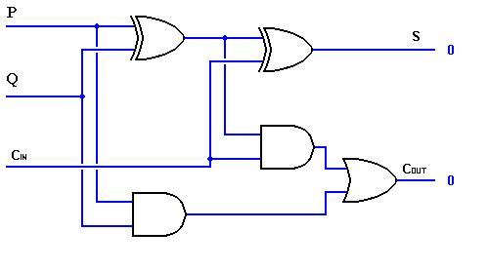
Gate- or Logic-Level Fault Models
Most popular models (due to their accuracy and relative tractability)
Line stuck faults
Stuck-at-0 (s-a-0)
Stuck-at-1 (s-a-1)
A
S
B
Short
(OR)
s-a-0
Line bridging faults
Unintended connection
(wired OR/AND)
C
K
Open
Line open faults
Often can be modeled as s-a-0 or s-a-1
Delay faults (less tractable than the previous fault types)
Signals experience unusual delays
Other faults
Coupling, crosstalk
Slide <number>
Notes:
<number>

Slide 8
Automatic test pattern generation (ATPG)
A
S
B
C
K
A fault is said to be detected by a test pattern if the output of that test pattern, when testing a device that has only that one fault, is different than the expected output. The ATPG process for a targeted fault consists of two phases: fault activation and fault propagation.
Slide <number>

Slide 9
1.2 Path Sensitization and D-Algorithm
The main idea behind test design: control the faulty point from inputs and propagate its behavior to some output
Example: s-a-0 fault
Test must force the line to 1
A
1
S
B
1/0
Two possible tests
(A, B, C) = (0 1 1) or (1 0 1)
s-a-0
1/0
C
1/0
1
K
This method is formalized in the D-algorithm
0
Backward trace
Forward trace
(sensitization)
D-calculus
1/0 on the diagram above is represented as D
0/1 is represented as D
Slide <number>
Notes:
<number>
Fujiwara, H., Logic Testing and Design for Testability, MIT Press, 1985.

Slide 10
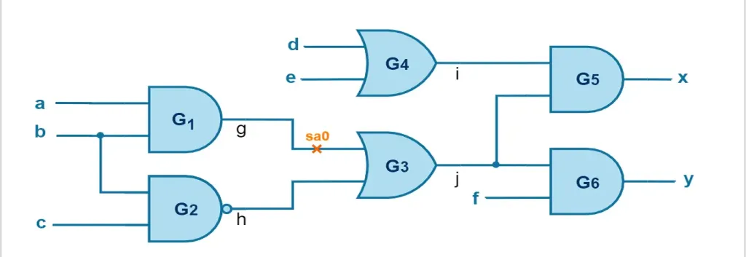
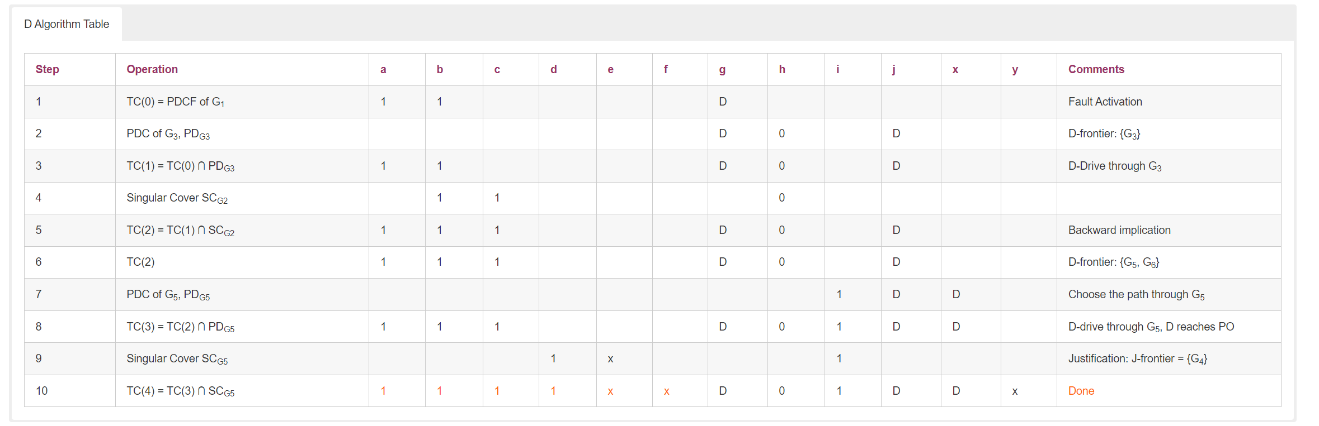
D-Algorithm
Propagation D-cube (PDC)
Primitive D-cube of a fault (PDCF)
Slide <number>
Notes:
<number>
Fujiwara, H., Logic Testing and Design for Testability, MIT Press, 1985.

Slide 11
Selection of a Minimal Test Set
Each input pattern detects a subset of all possible faults of interest (according to our fault model)
A
E
M
N
A B C P Q
s-a-0 s-a-1 s-a-0 s-a-1
0 0 0 - - - x
0 0 1 - x - x
0 1 1 x - x -
1 0 1 x - x -
S
G
J
B
P
Q
C
L
F
K
R
H
Choosing a minimal test set is a covering problem
Equivalent faults: e.g., P s-a-0 ≡ L s-a-0 ≡ Q s-a-0
Q s-a-1 ≡ R s-a-1 ≡ K s-a-1
Slide <number>
Notes:
<number>

Slide 12
1.3 Boolean Difference Methods
K = f(A, B, C) = AB ∨ BC ∨ CA
dK/dB = f(A, 0, C) ⊕ f(A, 1, C)
= CA ⊕ (A ∨ C)
= A ⊕ C
E
A
M
N
S
G
J
B
s-a-0
Q
P
K = PC ∨ AB
dK/dP = AB ⊕ (C ∨ AB) = C(AB)
C
L
F
K
R
H
Tests that detect P s-a-0 are solutions to the equation P dK/dP = 1
(A ⊕ B) C(AB) = 1 ⇒ C = 1, A ≠ B
Tests that detect P s-a-1 are solutions to the equation P dK/dP = 1
(A ⊕ B) C(AB) = 1 ⇒ C = 1, A = B = 0
Slide <number>
Notes:
<number>
Fujiwara, H., Logic Testing and Design for Testability, MIT Press, 1985.

Slide 13
1.4 The Complexity of Fault Testing
The satisfiability problem (SAT)
Decision problem: Is a Boolean expression satisfiable?
(i.e., can we assign values to the variables to make the result 1?)
Theorem (Cook, 1971): SAT is NP-complete
In fact, even restricted versions of SAT remain NP-complete
Theorem (Cook, 1971): 3SAT is NP-complete
In 3SAT, the logic expression is a product of 3-term OR clauses
According to the Boolean difference formulation, fault detection can be converted to SAT (find the solutions to P dK/dP = 1)
To prove the NP-completeness of fault detection, we need to show that SAT (or another NP-complete problem) can be converted to it
Proof of NP-completeness is due to Ibarra and Sahni [Ibar75]
A simple alternate proof by Fujiwara [Fuji82] is in the textbook
Slide <number>
Notes:
<number>
Fujiwara, H., Logic Testing and Design for Testability, MIT Press, 1985.

Slide 14
Proof that Fault Detection is NP-Complete
Theorem (Cook, 1971): 3SAT is NP-complete
Theorem: Clause-monotone SAT (CM-SAT) is NP-complete
CM-SAT has OR clauses each of which consists entirely of complemented or uncomplemented variables, but not both
3SAT can be converted to CM-SAT by replacing each mixed OR clause with the product of two clauses involving a new variable
Example: (x_{i} ∨ x_{j} ∨ x ′_{k}) is replaced by (x_{i} ∨ x_{j} ∨ v_{k})(v ′_{k} ∨ x ′_{k})
Clause-monotone SAT can be converted to fault detection in a circuit
First level has ANDs for all clauses with complemented variables
Second level has ORs for all clauses with uncomplemented variables, plus an OR gate with level-1 outputs as its inputs (one input to this gate is y)
Third level has one AND gate that receives all level-2 outputs as its inputs
A test for y s-a-1 satisfies the original clause-monotone expression
Slide <number>
Notes:
<number>
Fujiwara, H., Logic Testing and Design for Testability, MIT Press, 1985.

Slide 15
1.5 Testing of Units with Memory
The presence of memory expands the number of required test cases
To test a sequential machine, we may need to apply different input sequences for each possible initial state
Exponentially many possible input sequences
Exponentially many possible machine states
Slide <number>
Notes:
<number>

Slide 16
Testing of Memory
Simple-minded approach: Write 000 . . . 00 and 111 . . . 11 into every memory word and read out to verify proper storage and retrieval
Problems with the simple-minded approach:
● Does not test access/decoding mechanism – How do you know
the intended word was written into and read from?
● Many memory faults are pattern-sensitive, where cell operation
is affected by the values stored in nearby cells
● Modern high-density memories experience dynamic faults that
are exposed only for specific access sequences
Memory testing continues to be an active research area
Built-in self test is the only viable approach in the long term
Challenge: Any run time testing consumes some memory bandwidth
Slide <number>
Notes:
<number>
Consider the extreme case of the decoder always selecting the same memory word (all decoder outputs stuck on 0, say). Then, what you will be testing is the proper functioning of a single memory word.
Hamdioui, S., and G. Gaydadjiev, “Future Challenges in Memory Testing”

Slide 17

2 Design for Testability
Slide <number>
Notes:
<number>

Slide 18
2.1 The Importance of Testability
A small circuit with a limited number of inputs and outputs can be tested with a reasonable amount of effort and time
A complex unit, such as a microprocessor, cannot be tested solely based on its input/output behavior
Hence, the need for provisions in the design to facilitate testing
Slide <number>
Notes:
<number>

Slide 19
2.2 Testability Modeling
To allow detection of a fault in point A of a logic circuit, we need to:
Be able to control that point from the primary inputs
Be able to observe that point from the primary outputs
Thus, good testability requires
good controllability and
good observability
for every node in the circuit
Circuit under test (CUT)
A
Slide <number>
Notes:
<number>

Slide 20
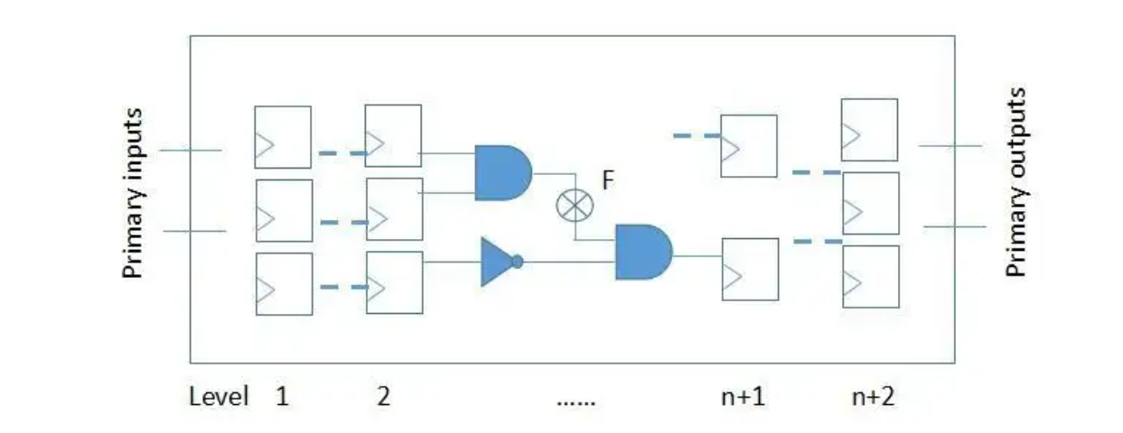
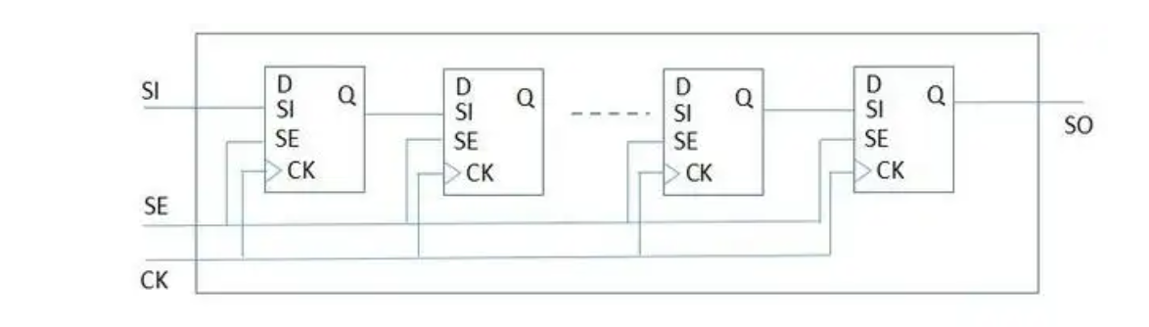
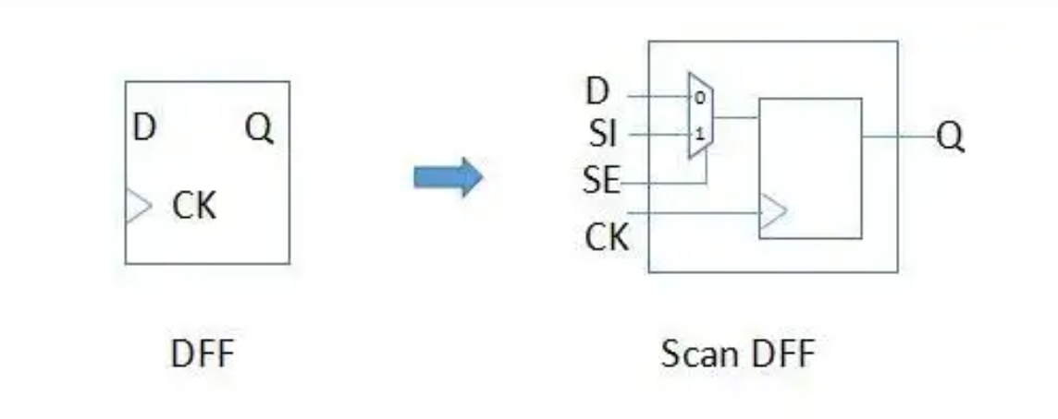
2.3 DFT
Slide <number>
Notes:
<number>

Slide 21
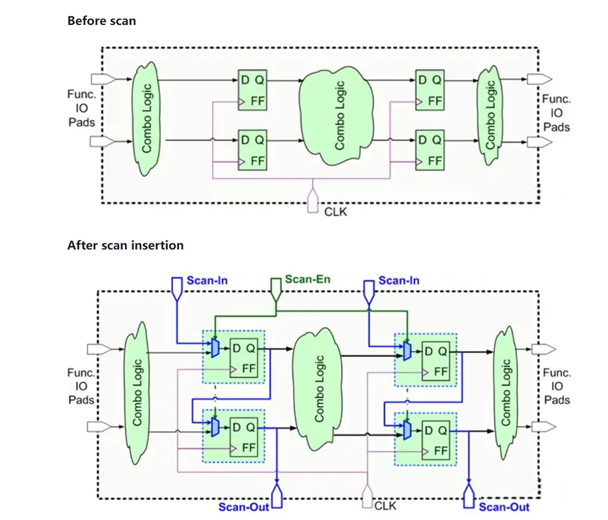
2.3 DFT
Slide <number>
Notes:
<number>

Slide 22
2.4 Built-in Self-Test (BIST)
Reference value
Ordinary testing
Test pattern
source
Circuit under test
(CUT)
Comparison
Pass/Fail
Built-in self-testing
Test pattern
generation
Circuit under test
(CUT)
Decision
Pass/Fail
Test patterns may be generated (pseudo)randomly – e.g., via LFSRs
Decision may be based on compressed test results
Part III – Faults: Logical Deviations
Slide <number>
Notes:
<number>
Fujiwara, H., Logic Testing and Design for Testability, MIT Press, 1985.

Slide 23

3 Replication and Voting
Slide <number>
Notes:
<number>

Slide 24
3.1 Hardware Redundancy Overview
Data path methods:
Replication in space (costly)
Duplicate and compare
Triplicate and vote
Pair-and-spare
NMR/hybrid
Replication in time (slow?)
Recompute and compare
Recompute and vote
Alternating logic
Recompute after shift
Recompute after swap
Replicate operand segments
Mixed space-time replication
Monitoring (imperfect coverage)
Watchdog timer
Activity monitor
Low-redundancy coding
Parity prediction
Residue checking
Self-checking design
Control unit methods:
Coding of control signals
Control-flow watchdog
Self-checking design
Glue logic methods:
Self-checking design
Control unit
Control signals
Condition signals
Glue logic
…
…
…
Inputs
.
.
.
.
.
.
Outputs
…
…
…
Data path
Slide <number>
Notes:
<number>

Slide 25
3.2 Replication in Space
Switch
The following schemes have already been discussed in connection with fault masking
1
2
C
Error
S
Comparators
1′
1
C
2′
Error
2
C
Error
Pair-and-spare
Comparator
Duplicate and compare
1
S
1
2
Voting unit
V
2
V
3
3
4
Switch-voting unit
Spare
Triplicate and vote
NMR/Hybrid
Slide <number>
Notes:
<number>

Slide 26
Static Redundancy with Replication
TMR:
?
R = 3R_{m}² – 2R_{m}³ > R_{m}
1
Voting unit
Condition on the module reliability:
R = R_{m} [1 + (1 – R_{m})(2R_{m} – 1)]
(1 – R_{m})(2R_{m} – 1) > 0 ⇒ R_{m} > 1/2
2
V
3
R
R
1.0
1.0
TMR better
TMR
0.5
0.5
Simplex better
Simplex
0.0
R_{m}
0.0
λt
0.0
0.5
1.0
0
ln 2
5
1
6
RIF_{TMR/Simplex} = (1 – R_{m})/(1 – R)
= 1/[1 – R_{m}(2R_{m} – 1)]
MTTF: TMR 5/(6λ)
Simplex 1/λ
Slide <number>
Notes:
<number>

Slide 27
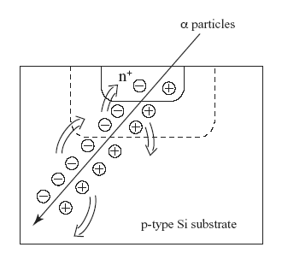
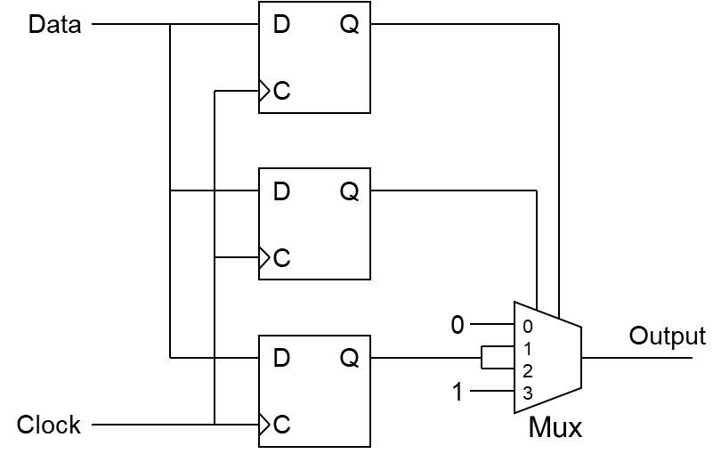
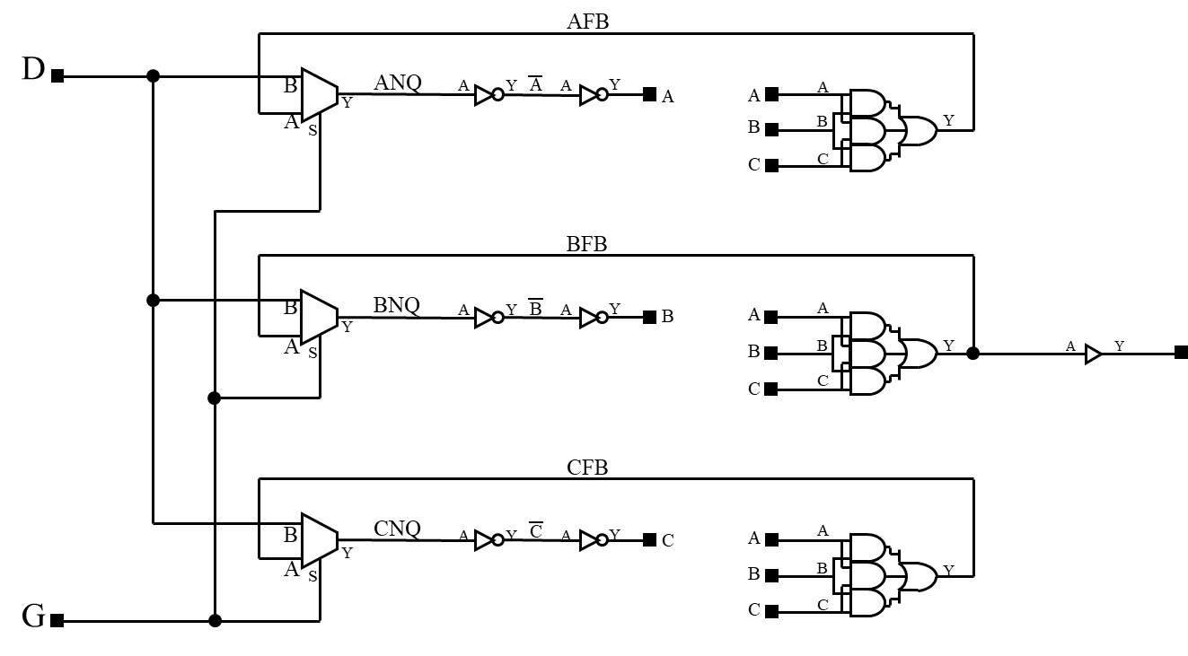
A TMR Application and Its Bit-Voting Unit
Single-event upset (SEU) = Soft error
Change of state caused by a high-energy particle strike
n⁺ diffusion layer
pn junction field
due to impact
SEU effect on DRAMs
(from SANYO website)
TMR flip-flop for SEU tolerance
Notes:
<number>

Slide 28
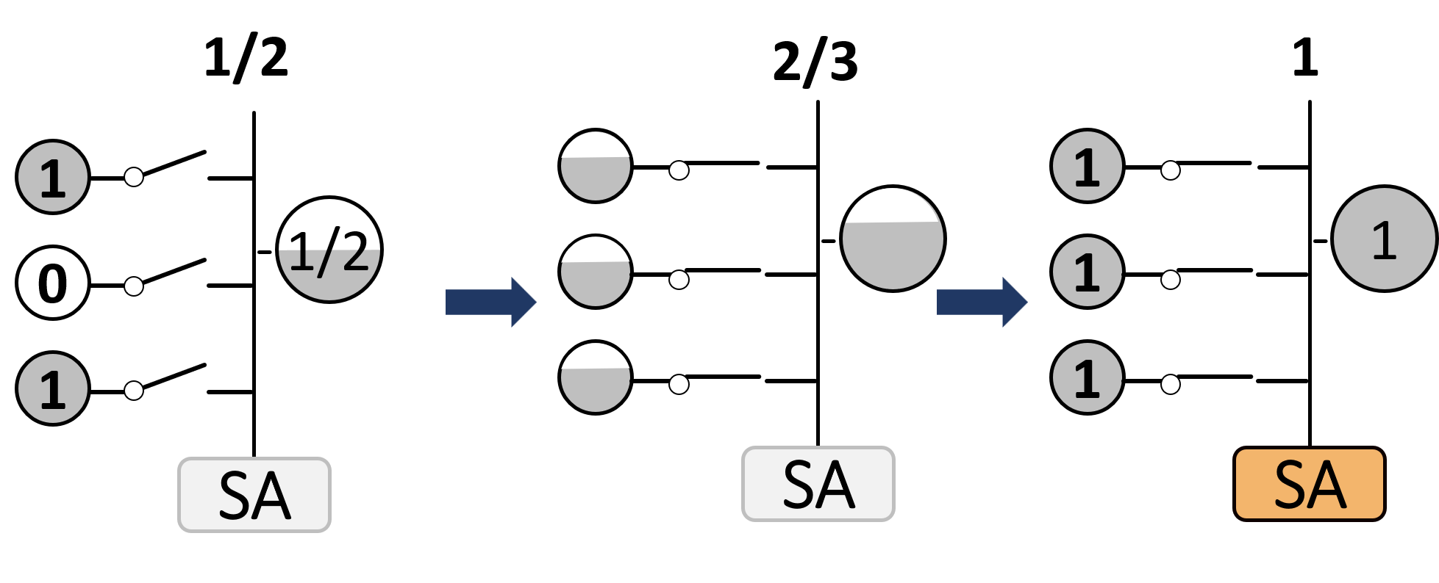
A TMR Application: in-DRAM Voting
Slide <number>

Slide 29
N-Modular Redundancy (NMR)
Triple-modular redundancy (TMR) can be generalized to N units
N-modular redundancy (NMR) uses N modules along with a voter, with N usually being odd
1
Example: 5MR
Operates correctly as long as
3 of the 5 modules are healthy
1
2
Voting unit
2
V
3
Voter complexity rises rapidly with increasing N
3
4
5
Even values of N are also feasible
Example: 4MR, with 3-out-of-4 voting
Voter masks single faults; can be designed to detect double faults
Slide <number>
Notes:
<number>

Slide 30
Dynamic and Hybrid Redundancy
Detector
1. Detect and replace
Dynamic redundancy (cold/hot standby)
Detection via
-- coding, watchdog timer, self-checking
-- duplication (pair-and-spares)
1
D
2
Spare
2. Mask in place
Static redundancy
May revert to simplex instead of duplex
Design challenges include
-- synchronization for voting
-- voting on imprecise results
1
Voting unit
2
V
3
1
S
3. Mask, diagnose, and reconfigure
Hybrid redundancy
Fault masked at output, but diagnosed
-- e.g., via comparison with voter output
Faulty circuit is replaced by spare
Becomes static upon spare exhaustion
2
V
3
4
Switch-voter
Spare
Slide <number>
Notes:
<number>

Slide 31
Comparing Replication Schemes
Advantages Drawbacks
Detector
Less power Coverage factor
(cold standby)
Long life Tolerance latency
(just add spares)
1
D
2
Spare
1
Immediate masking Power/area penalty
High safety Voting critical
Voting unit
2
V
3
Immediate masking Power/area penalty
Long life and Switch-voting critical
high safety
1
S
2
V
3
4
Switch-voting
unit
Spare
Slide <number>
Notes:
<number>

Slide 32
Switch for Standby Redundancy
Standby redundancy requires an n-to-1 switch to select the output of the currently active module
Detector
1
D
The detectors use various info
to deduce fault conditions
-- Error coding
-- Reasonableness checks
-- Watchdog timer
2
Spare
1
D
2
D
n-to-1 switch
Once a fault has been detected,
the switch reconfigures the system by flagging the faulty unit and activating next spare in sequence
Spares
3
D
If we use an n-to-2 switch and compare the two selected outputs, the configuration is known as “pair-and-spares”
Slide <number>
Notes:
<number>

Slide 33
TMR with Imperfect Voting Unit
?
R = R_{v}(3R_{m}² – 2R_{m}³) > R_{m}
1
Voting unit
Condition on the voting unit reliability
R_{v} > 1 / [3R_{m} – 2R_{m}²]
2
V
3
dR_{v}^{min}/ dR_{m} = (–3 + 4R_{m}) / (3R_{m} – 2R_{m}²)²
R_{v}
Condition on the module reliability
0.95
3 – 9 – 8/R_{v}
4
3 + 9 – 8/R_{v}
4
TMR better
< R_{m} <
0.885
Example: R_{v} = 0.95 requires that
0.56 < R_{m} < 0.94
Simplex better
R_{m}
0.5
0.75
1.0
0.56
0.94
When R_{v} = 1 – ε is close to 1, we have
1/R_{v} ≈ 1 + ε and (1 – 8ε)^{0.5} ≈ 1 – 4ε, leading to 0.5 + ε < R_{m} < 1 – ε
Slide <number>
Notes:
<number>

Slide 34
TMR with Compensating Faults
R_{m} = 1 – p₀ – p₁ (0- and 1-fault probabilities)
1
Voting unit
R = (3R_{m}² – 2R_{m}³) + 6p₀p₁R_{m}
2
V
Example: R_{m} = 0.998, p₀ = p₁ = 0.001
R = 0.999,984 + 0.000,006 = 0.999,990
Basic TMR Compensation
RIF_{TMR/Simplex} = 0.002 / 0.000,016 = 125
RIF_{Compen/TMR} = 0.000,016 / 0.000,010 = 1.6
3
Slide <number>
Notes:
<number>

Slide 35
Replication in Time
Can be slow, but in many control applications, extra time is available
Interleaving of the primary and duplicate computations saves time
+
+
Duplicate computation
t₀
t₀ + 1
+
+
Duplicate computation
×
+
×
+
+
Schedule
with 1 adder
+
t₀ + 2
×
×
Computation flowgraph, and schedule with 2 adders
Slide <number>
Notes:
<number>

Slide 36
Recompute and Compare / Vote
Repeat computation and store the results for comparison or voting
Comparison or voting need not be done right away; primary result may be used in further computations, with the result subsequently validated, if appropriate
+
+
Duplicate computation
On a simultaneous multithreading architecture, multiple instruction streams may be interspersed
×
+
+
Triplicate computation
×
+
+
Some Cray machines take advantage of extensive hardware resources to execute instructions twice
×
Use as operand in further computations, while awaiting confirmation of validity
Slide <number>
Notes:
<number>

Slide 37
Mixed Space/Time Replication
Instead of duplicating the computation with no hardware change (slow) or duplicating the entire hardware (costly), we can add some hardware
to make the interleaved recomputations more efficient
+
Recomputation with same hardware resources (T = 5, excluding compare time)
Consider the effect of including a second adder
+
Duplicate computation
Recomputation
with the inclusion
of an extra adder
(T = 3, excluding compare time)
×
+
+
+
Original
computation
(T = 3)
+
×
+
+
×
×
Slide <number>
Notes:
<number>

Slide 38
Switching and Voting Units
We begin with some simple voting unit designs:
If in the case of 3-way disagreement any of the inputs can be chosen, then a simple design is possible
x₁
Disagree
1
Compare
x₂
2
0
1
y
x₃
This design can be readily generalized to a larger number of inputs
3
One can perform pseudo voting that yields the median of 3 analog signals (Dennis, N.G., Microelectronics and Reliability, Aug. 1974)
Median and mean voting are also possible with digital signals
Slide <number>
Notes:
<number>

Slide 39
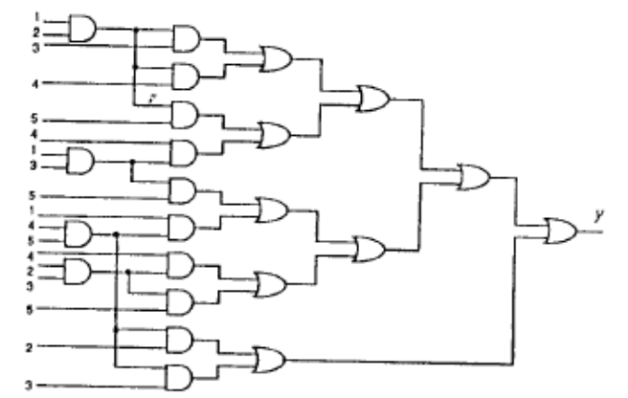
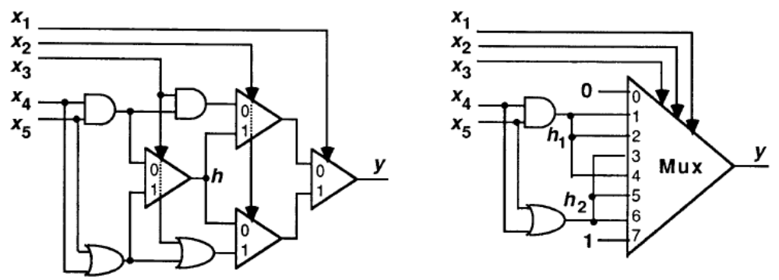
Implementing a Bit-Voting Unit
TMR bit-voting: y = x₁x₂ ∨ x₂x₃ ∨ x₃x₁
(carry output of a single-bit full-adder)
What about 5MR, 7MR?
1
x₁
Bit-voting unit
x₂
V
2
y
Gate-level design quickly explodes in size
3
x₃
Other designs are also possible
Arithmetic: add the bits, compare to threshold
Mux-based
Selection-based (majority of bit values is their median)
3-out-of-5 voting unit built of 2-input gates
Two mux-based designs for a 3-out-of-5 bit-voting unit
Slide <number>
Notes:
<number>

Slide 40
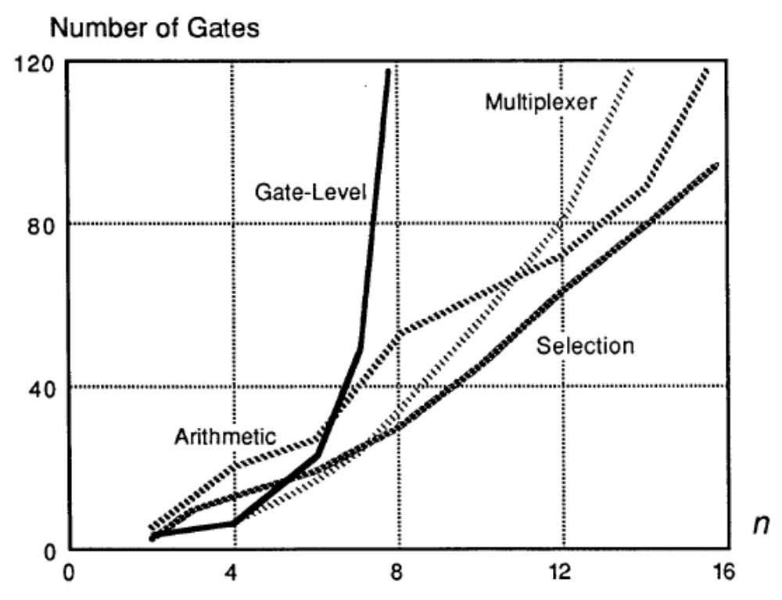
Complexity of Different Bit-Voting Unit Designs
Cost of majority bit-voting units as a function of the number n of inputs
Slide <number>
Notes:
<number>

Slide 41
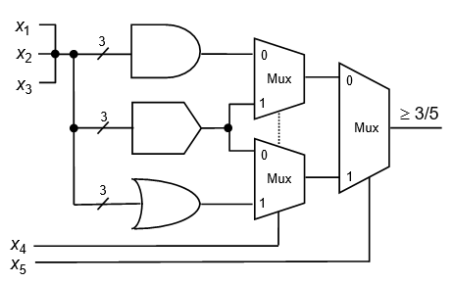
Majority-Friendly Nanotechnologies
Certain new nanotechnologies offer efficient majority gates
Can we use majority gates as building-blocks in realizing voters?
Slide <number>
Notes:
<number>

Slide 42
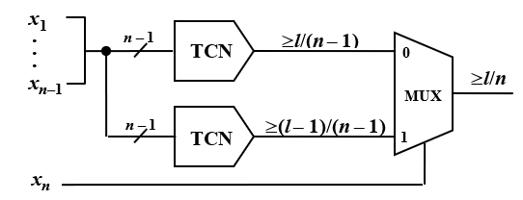
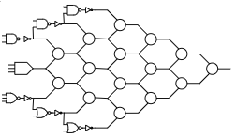
Recursive Construction of Large Voters
At-least-l-out-of-n threshold counting network built from a multiplexer and two smaller threshold counting networks
x₅
Recursively-built
5-out-of-9 voter
x₄
x₆
x₅
x₇
x₁, x₂, x₃
x₄
x₆
x₈
x₅
x₇
x₉
x₁, x₂, x₃
x₄
x₆
x₈
x₅
x₇
x₁, x₂, x₃
x₆
x₄
x₅
Part III – Faults: Logical Deviations
Slide <number>
Notes:
<number>

Slide 43
Voting at the Word Level
Using bit-by-bit voting may be dangerous
x₁ = 0 0
x₂ = 1 0
x₃ = 1 1
y = 1 0
One might think that in this example, any of the module outputs could be correct, so that producing 1 0 at the output isn’t all that wrong
x₁ = 0 0 0
x₂ = 1 0 1
x₃ = 1 1 0
y = 1 0 0
However, with bit-by-bit voting, the output may be different from all inputs
Design of bit- and word-voting networks discussed in:
Parhami, B., “Voting Networks,” IEEE TR, Aug. 1991
Slide <number>
Notes:
<number>

Slide 44
Variations and Design Issues
NMR/simplex: Voting unit is replaced with a unit that can also detects disagreements
1
Voting unit
2
V
When a faulty unit is detected, that unit and one other unit are removed from service
3
This makes all votes unambiguous and also improves systems lifetime
Self-purging redundancy: Modules purged when they disagree with the output and the threshold of the voting unit is adjusted accordingly
(purged modules produce 0 outputs)
S
R
Q
T
Module
output
Slide <number>
Notes:
<number>

Slide 45
Alternating Logic: Basic Ideas
Transmission of data over unreliable wires or buses
Send data; store at receiving end
Send bitwise complement of data
Compare the two versions
Detects wires s-a-0 or s-a-1, as well as many transients
The dual of a Boolean function f(x₁, x₂, . . . , x_{n}) is another function
f_{d}(x₁, x₂, . . . , x_{n}) such that f_{d}(x₁′, x₂′, . . . , x_{n}′) = f ′(x₁, x₂, . . . , x_{n})
Fact: Obtain the dual of f by exchanging AND and OR operators in its logical expression. For example, the dual of f = ab ∨ c is f_{d} = (a ∨ b)c
Advantages of this approach compared with duplication include a smaller probability
of common errors
Inputs
f
Output
Error
Compl. inputs
f_{d}
Slide <number>
Notes:
<number>

Slide 46
Alternating Logic: Self-Dual Functions
A function f is self-dual if f(x₁, x₂, . . . , x_{n}) = f_{d}(x₁, x₂, . . . , x_{n})
For example, both the sum a ⊕ b ⊕ c and carry ab ∨ bc ∨ ca outputs of a full-adder are self-dual functions
Use same circuit twice
Inputs
f
Output
Error
Compl. inputs
f_{d}
With a self-dual function f, the functions f and f_{d} in the diagram above can be computed by using the same circuit twice (time redundancy)
Many functions of practical interest are self-dual
Examples (proofs left as exercise)
A k-bit binary adder, with 2k + 1 inputs and k + 1 outputs, is self-dual
So are 1’s-complement and 2’s-complement versions of such an adder
Slide <number>
Notes:
<number>

Slide 47
Recomputing with Transformed Operands
Alternating logic is a special case of the following general scheme, with its encoding and decoding functions being bitwise complementation
Inputs
f
Output
Encode
Decode
Error
Inputs
e
g
d
XNOR if lower path finds complement of the result
Recompute after shift
When f is binary addition, we can use shifts for encoding and decoding
Shifting causes the adder circuits to be exercised differently each time
Originally proposed for ALUs with bit-slice organization
Recompute after swap
When f is binary addition, we can use swaps for encoding and decoding
Swap the two operands; e.g., compute b + a instead of a + b
Swap upper and lower halves of the two operands (modified adder)
Slide <number>
Notes:
<number>

Slide 48
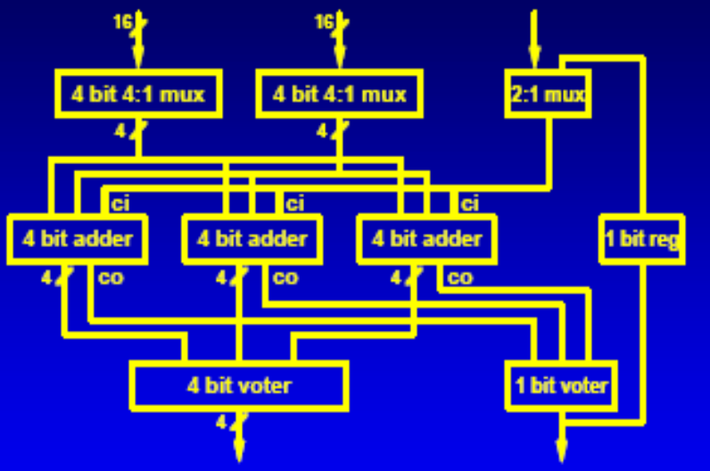
Time-Redundant, Segmented Addition
Instead of using a k-bit adder twice for error detection or 3 times for error correction, one can segment the operands into 2 or 3 parts and similarly segment the adder; perform replicated addition on operand segments and use comparison/voting to detect/correct error
FF
c_{in}
Sum computed in two cycles: The lower half in cycle 1, and
the upper half in cycle 2
c_{out}
x_{L}
Lower half of adder
x_{H}
y_{L}
Upper half of adder
C
Error
y_{H}
Comparator
Various other segmentation schemes have been suggested
Example: 16-bit adder with
4-way segmentation and voting
Townsend, Abraham, and Swartzlander, 2003
Slide <number>
Notes:
<number>
Whitney J. Townsend, Jacob A. Abraham, and Earl E. Swartzlander, Jr., “Quadruple Time Redundancy Adders [Error Correcting Adder],” Proc. 18th IEEE Int’l Symp. Defect and Fault Tolerance in VLSI Systems, pp. 250-256, 2003.

